Slide 1

DATA SCIENCE PROJECT
Diamond Price Prediction
Uncovering the true drivers of diamond price and building a regression model to predict it
53,940 Diamonds Analyzed
4 Regression Models Compared
Final Model: Linear Regression

Slide 2






Agenda
1. Data Understanding
2. Exploratory Analysis
Dataset shape, quality, and cleaning steps
What drives diamond price — carat, cut, color, clarity
3. Model Building
4. Evaluation
Four regression models trained and compared
MAE, RMSE, R² — selecting the best model
5. Prediction
6. Conclusion
Estimating price for a new diamond
Key takeaways and recommendations
Diamond Price Prediction
2

Slide 3
Dataset Overview
53,940 diamonds — carat, cut, color, clarity, proportions, and price
53,940
10
146
50,400
Total Records
Attributes
Duplicates Removed
Records After Cleaning
Columns
Data Quality Steps
carat
cut
color
clarity
depth
table
price (target)
x, y, z (mm)
No missing values found
146 duplicate records removed
Price outliers removed via IQR rule (1.5× IQR)
Categorical features label-encoded (cut, color, clarity)
All features standardized (StandardScaler)
Diamond Price Prediction
3

Slide 4
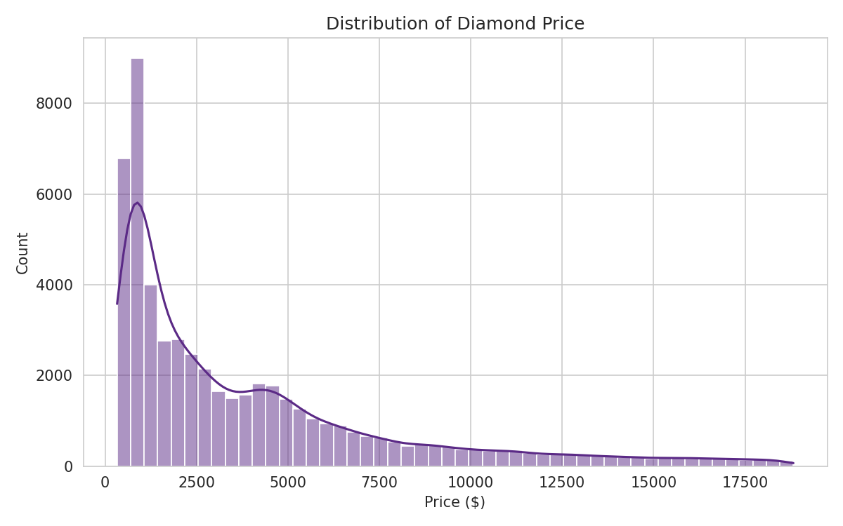
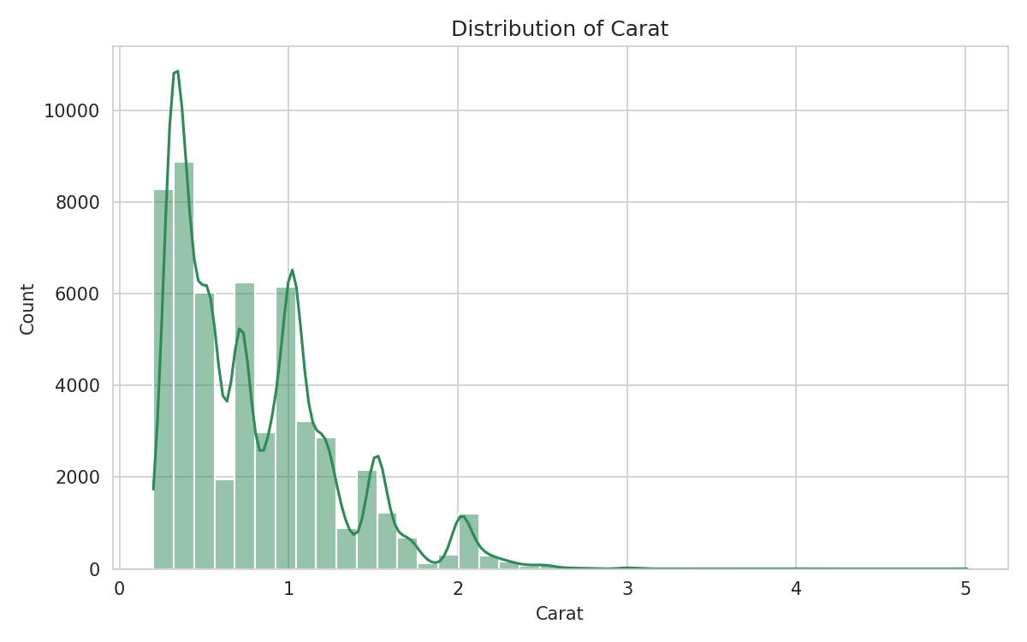
Price & Carat Distribution
Most diamonds are modestly priced and modestly sized — the distributions are right-skewed
Price: Concentrated under $5,000, with a long tail of high-value diamonds. Carat: Most diamonds fall between 0.2 and 1.5 carats.
Diamond Price Prediction
4

Slide 5
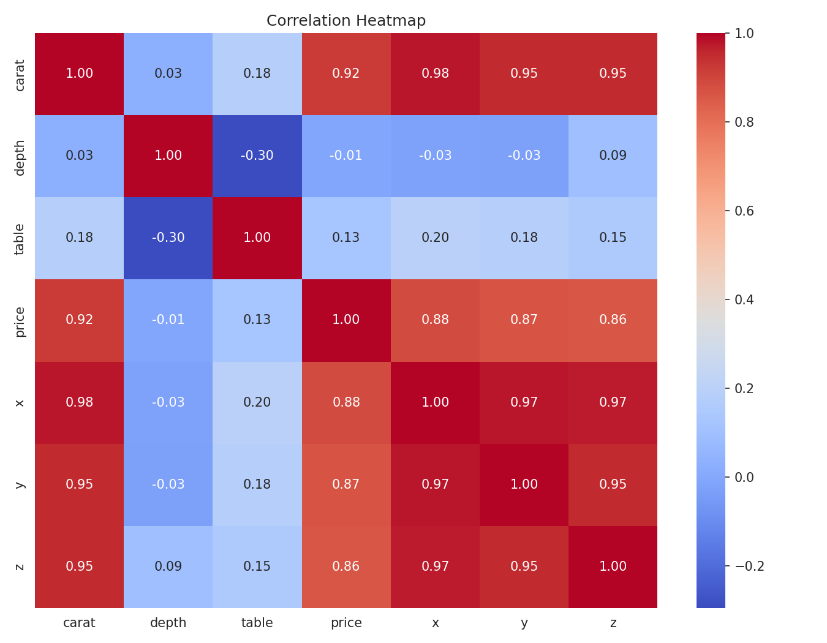
Q1. What Drives Diamond Price the Most?
Carat has the strongest correlation with price (r = 0.92) — the single most influential feature.
Diamond Price Prediction
5

Slide 6
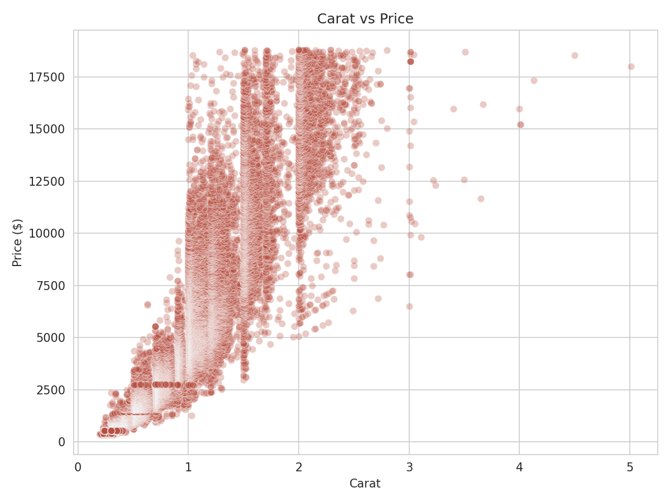
Q2. Does Higher Carat Always Mean Higher Price?
Generally, yes
Carat and price move strongly together — the scatter plot shows a clear positive, though non-linear, relationship.
But not always at the individual level
At the same carat weight, price still varies considerably based on cut, color, and clarity. Carat is the dominant driver, not the only one.
Two diamonds of equal carat can differ by thousands of dollars based on quality grade.
Diamond Price Prediction
6

Slide 7
Q3–Q5. Price by Cut, Color & Clarity
Counter-intuitive at first glance: Premium cut, J color, and SI2 clarity show the highest averages — not the “best” grades. This is carat-weight confounding: larger, heavier stones in this dataset happen to carry these grades more often, pulling their average price up. Holding carat constant, better cut/color/clarity still commands a premium.
Diamond Price Prediction
7

Slide 8
Modeling Approach
From raw data to a trained, evaluated model
1
2
3
4
5
6
Clean
Encode
Scale
Split
Train
Evaluate
Remove duplicates & price outliers (IQR)
→
Label-encode cut, color, clarity
→
Standardize all features
→
80% train / 20% test
→
4 regression models
→
MAE, RMSE, R², Adj. R²
Models: Linear Regression · Ridge · Lasso · Elastic Net
Diamond Price Prediction
8

Slide 9
Q6. Which Model Performs Best?
Model | MAE | RMSE | R²
Linear Regression ★ | $651 | $967 | 0.8732
Ridge Regression | $651 | $967 | 0.8732
Lasso Regression | $651 | $967 | 0.8732
Elastic Net | $721 | $1,006 | 0.8628
Linear Regression
R² = 0.873 · RMSE = $967
Best overall performance, nearly tied with Ridge & Lasso — regularization added little value with only 9 predictors.
Diamond Price Prediction
9

Slide 10
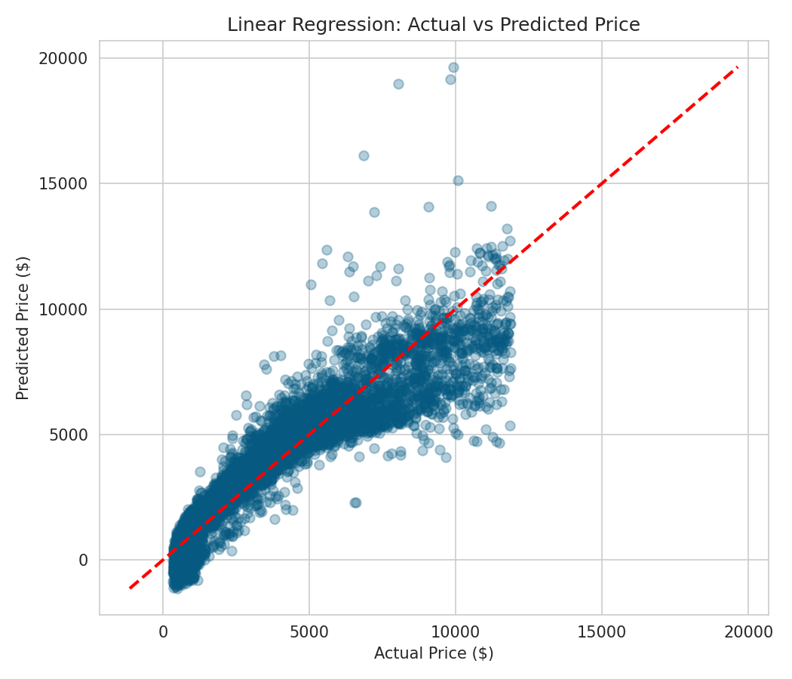
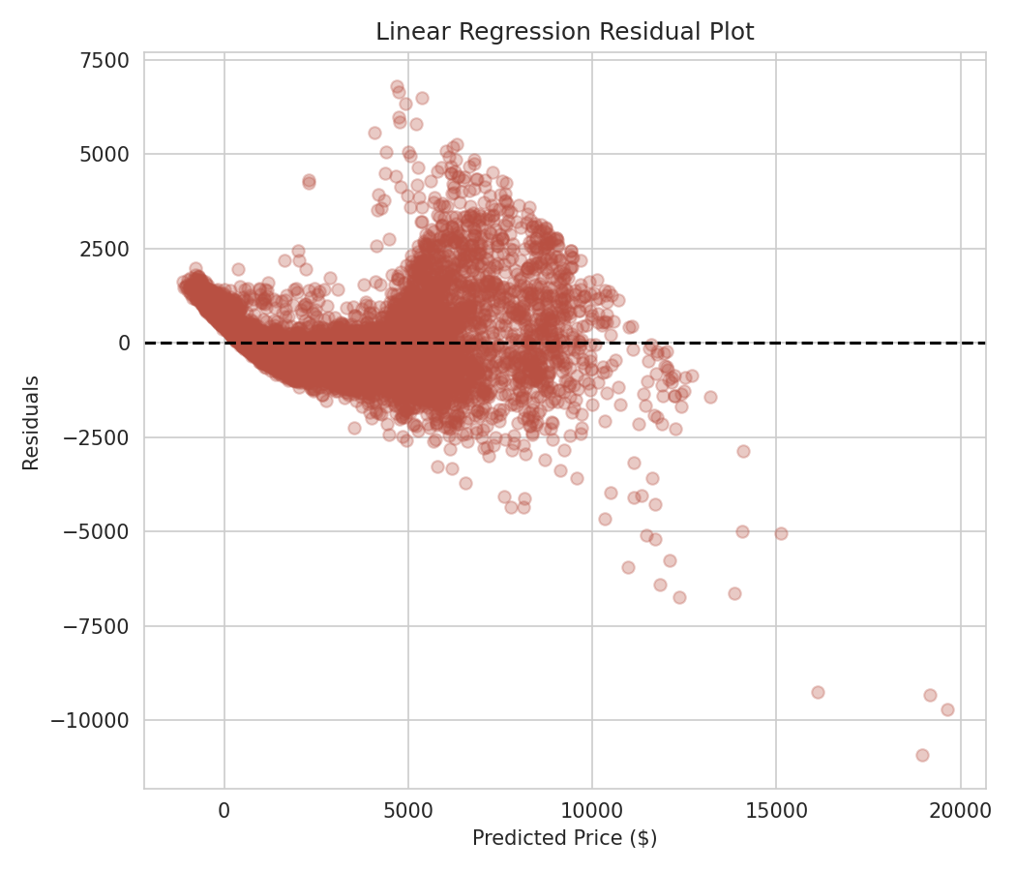
Model Diagnostics
Linear Regression: how well predictions track actual prices
Predictions closely track actual prices along the diagonal.
Residuals widen at higher prices — less precision for luxury-tier diamonds.
Diamond Price Prediction
10

Slide 11

Q7. Predicting a New Diamond's Price
Specifications
Carat | 1.20
Cut | Premium
Color | G
Clarity | VS2
Depth | 61.8
Table | 57
x / y / z (mm) | 6.82 / 6.79 / 4.20
Predicted Price
$6,803.60
± $967 (typical model error)
Generated using the trained Linear Regression model on encoded, scaled inputs.
Diamond Price Prediction
11

Slide 12

Conclusion & Recommendations
Carat rules
Quality is secondary — and confounded
Carat weight is overwhelmingly the strongest single driver of diamond price — weight it most heavily in any pricing tool.
Cut, color, and clarity have real but secondary effects; raw averages are confounded by carat and should be read alongside it.
Linear Regression wins, narrowly
Luxury tier needs more care
Linear Regression gave the best balance of accuracy and interpretability (R² = 0.873); tree ensembles could push this further.
Prediction error grows for very high-priced diamonds — a separate model or added features (certification, fluorescence) may help.
Diamond Price Prediction
12

